Slide 1
Topic WAN Technologies
CCNA Routing and Switching
200-120 Examination
Jeng-Yueng Chen
Hsiuping University of Science and Technology

Slide 2
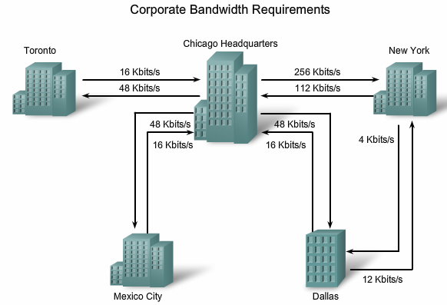
Introducing Frame Relay

Slide 3
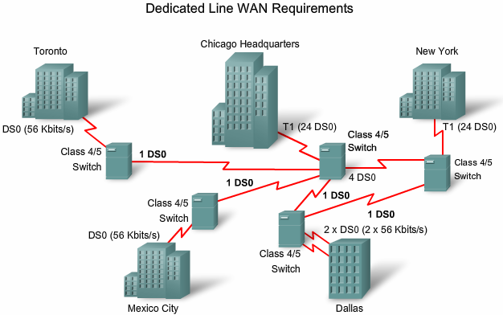
Introducing Frame Relay

Slide 4
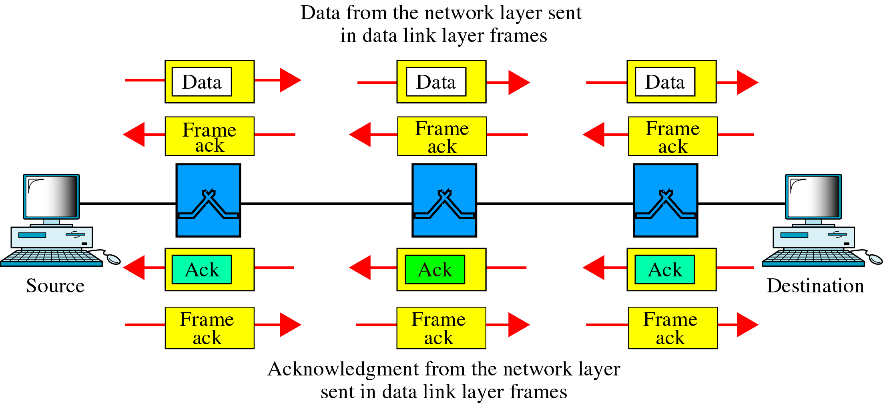
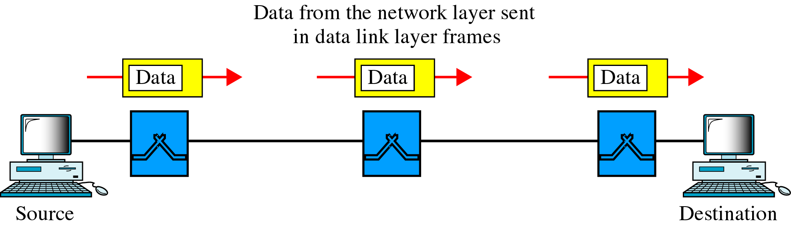
No Error Control
X.25 Traffic
Frame Relay Traffic

Slide 5
Virtual Circuits
The connection through a Frame Relay network between two DTEs is called a virtual circuit (VC)
There are two ways to establish VCs:
SVCs, switched virtual circuits, are established dynamically by sending signaling messages to the network (CALL SETUP, DATA TRANSFER, IDLE, CALL TERMINATION).
PVCs, permanent virtual circuits, are preconfigured by the carrier, and after they are set up, only operate in DATA TRANSFER and IDLE modes. Note that some publications refer to PVCs as private VCs.

Slide 6
Virtual Circuit
VP 與 VC 虛擬通道
虛擬路徑 (Virtual Path, VP)
虛擬通道 (Virtual Channel, VC)

Slide 7
Virtual Circuits
VCs provide a bidirectional communication path from one device to another
VCs are identified by DLCIs
DLCI values typically are assigned by the Frame Relay service provider (for example, the telephone company)
Frame Relay DLCIs have local significance, which means that the values themselves are not unique in the Frame Relay WAN
Two devices connected by a VC may use a different DLCI value to refer to the same connection

Slide 8
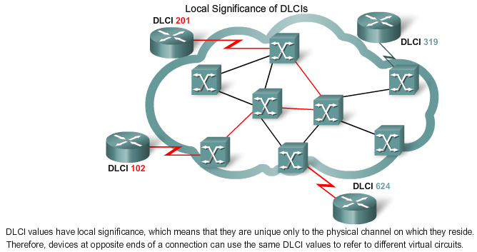
Virtual Circuits

Slide 9
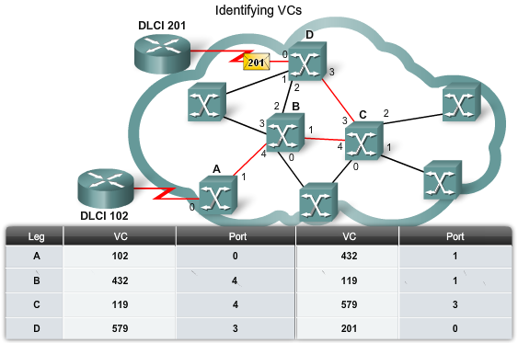
Virtual Circuits

Slide 10
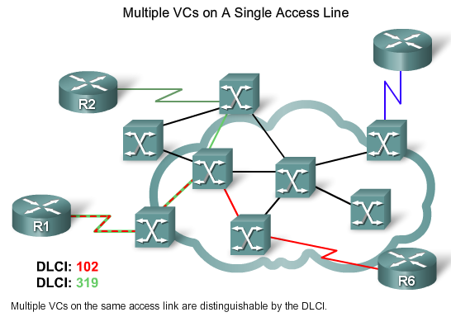
Virtual Circuits

Slide 11
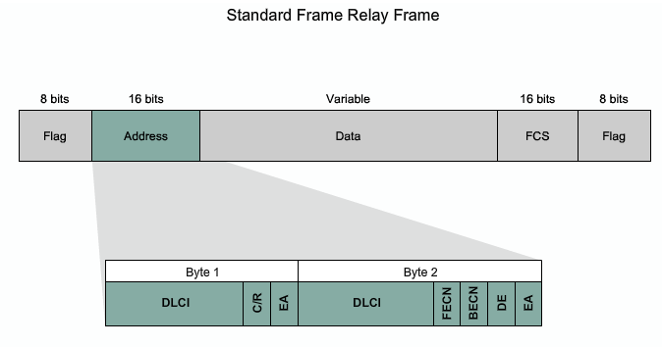
Frame Relay Encapsulation
DLCI - The 10-bit DLCI represents the virtual connection between the DTE device and the switch. Each virtual connection that is multiplexed onto the physical channel is represented by a unique DLCI. The DLCI values have local significance only.

Slide 12
Frame Relay Encapsulation
Extended Address (EA) - If the value of the EA field is 1, the current byte is determined to be the last DLCI octet. Although current Frame Relay implementations all use a two-octet DLCI, this capability does allow longer DLCIs in the future. The eighth bit of each byte of the Address field indicates the EA

Slide 13
Frame Relay Encapsulation
C/R - Follows the most significant DLCI in the Address field. The C/R bit is not generally used by Frame Relay

Slide 14
Frame Relay Encapsulation
Congestion Control - Contains 3 bits that control the Frame Relay congestion-notification mechanisms. The FECN, BECN, and DE bits are the last three bits in the Address field

Slide 15
Frame Relay Address Mapping
Before a Cisco router is able to transmit data over Frame Relay, it needs to know which local DLCI maps to the Layer 3 address of the remote destination
This address-to-DLCI mapping can be accomplished either by static or dynamic mapping

Slide 16
Frame Relay Address Mapping
The Inverse Address Resolution Protocol, also called Inverse ARP, obtains Layer 3 addresses of other stations from Layer 2 addresses, such as the DLCI in Frame Relay networks
Dynamic address mapping relies on Inverse ARP to resolve a next hop network protocol address to a local DLCI value
The Frame Relay router sends out Inverse ARP requests on its PVC to discover the protocol address of the remote device connected to the Frame Relay network

Slide 17
Frame Relay Address Mapping
To map between a next hop protocol address and DLCI destination address, use this command
frame-relay map protocol protocol-address dlci [broadcast] [ietf | cisco]
Use the keyword ietf when connecting to a non-Cisco router

Slide 18
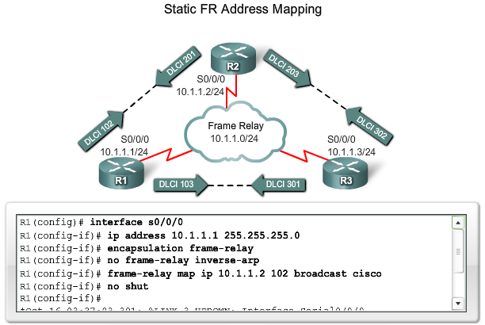
Frame Relay Address Mapping

Slide 19
LMI
Basically, the Local Management Interface (LMI) is a keepalive mechanism that provides status information about Frame Relay connections between the router (DTE) and the Frame Relay switch (DCE)
Every 10 seconds or so, the end device polls the network, either requesting a dumb sequenced response or channel status information
If the network does not respond with the requested information, the user device may consider the connection to be down. When the network responds with a FULL STATUS response, it includes status information about DLCIs that are allocated to that line

Slide 20
LMI Types
There are several LMI types, each of which is incompatible with the others. The LMI type configured on the router must match the type used by the service provider
Three types of LMIs are supported by Cisco routers
Cisco - Original LMI extension
Ansi - Corresponding to the ANSI standard T1.617 Annex D
q933a - Corresponding to the ITU standard Q933 Annex A

Slide 21
LMI Types
Starting with Cisco IOS software release 11.2, the default LMI autosense feature detects the LMI type supported by the directly connected Frame Relay switch
the router automatically configures its interface with the supported LMI type acknowledged by the Frame Relay switch
To set the LMI type:
Router(config-if)# frame-relay lmi-type [cisco | ansi | q933a]

Slide 22
LMI and Inverse ARP
LMI status messages combined with Inverse ARP messages allow a router to associate Network layer and Data Link layer addresses
Router sends an LMI status inquiry message to the network. The network replies with an LMI status message containing details of every VC configured on the access link
If the router needs to map the VCs to Network layer addresses, it sends an Inverse ARP message on each VC

Slide 23
Configuring Basic Frame Relay
Enable Frame Relay Encapsulation
Step 1. Setting the IP Address on the Interface
Router(config-if)# ip address IP-Addr NetMask
Step 2. Configuring Encapsulation
Router(config-if)# encapsulation frame-relay [cisco | ietf]
Step 3. Setting the Bandwidth
Router(config-if)# bandwidth Kbps
Step 4. Setting the LMI Type (optional)
Router(config-if)# frame-relay lmi-type [cisco | ansi | q933a]

Slide 24
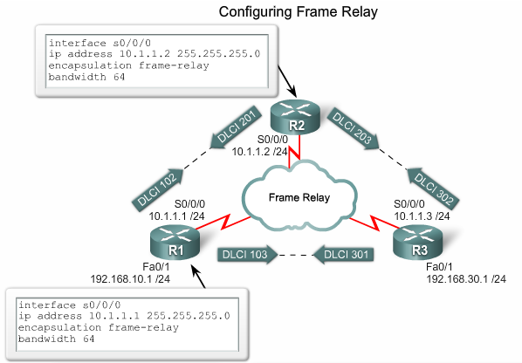
Configuring Basic Frame Relay

Slide 25
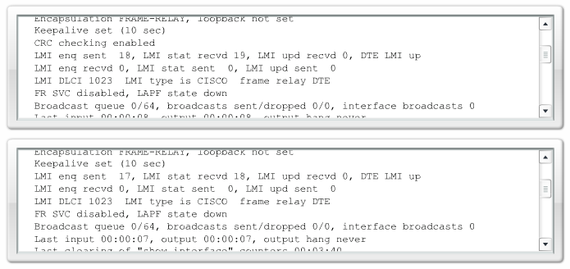
Configuring Basic Frame Relay
R1# show interfaces serial 0/0/0
R2# show interfaces serial 0/0/0

Slide 26
Static Frame Relay Map
To map between a next hop protocol address and a DLCI destination address:
Router(config-if)# frame-relay map protocol protocol-address dlci [broadcast]
Frame Relay, ATM, and X.25 are nonbroadcast multiaccess (NBMA) networks
NBMA networks do not support multicast or broadcast traffic
Because NBMA does not support broadcast traffic, using the broadcast keyword is a simplified way to forward routing updates. The broadcast keyword allows broadcasts and multicasts over the PVC and, in effect, turns the broadcast into a unicast so that the other node gets the routing updates

Slide 27
Split Horizon Problem
By default, a Frame Relay network provides NBMA connectivity between remote sites
NBMA clouds usually use a hub-and-spoke topology. Unfortunately, a basic routing operation based on the split horizon principle can cause reachability issues on a Frame Relay NBMA network
Solutions
Disabling split horizon
Only IP allows you to disable split horizon
Increases the chance of routing loops
Use a fully meshed topology
This is expensive because more PVCs are required
Use subinterfaces

Slide 28
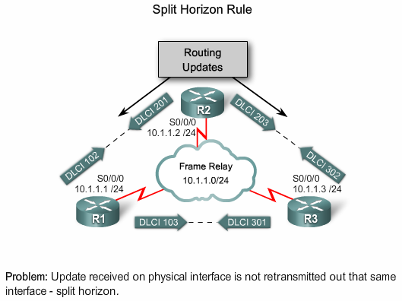
Split Horizon Problem

Slide 29
Frame Relay Subinterfaces
Frame Relay subinterfaces can be configured in either
Point-to-point - A single point-to-point subinterface establishes one PVC connection to another physical interface or subinterface on a remote router. In this case, each pair of the point-to-point routers is on its own subnet, and each point-to-point subinterface has a single DLCI
Multipoint - A single multipoint subinterface establishes multiple PVC connections to multiple physical interfaces or subinterfaces on remote routers. All the participating interfaces are in the same subnet. The subinterface acts like an NBMA Frame Relay interface, so routing update traffic is subject to the split horizon rule. Typically, all multipoint VCs belong to the same subnet.

Slide 30
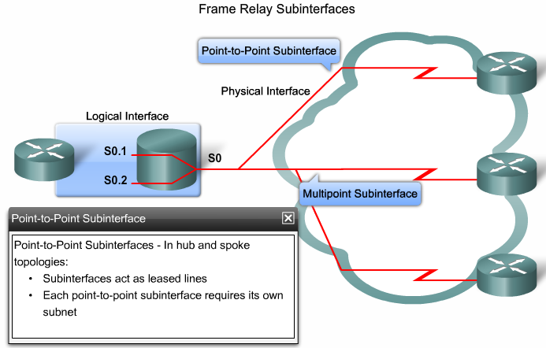
Frame Relay Subinterfaces

Slide 31
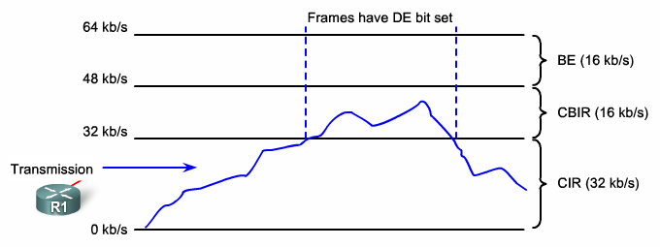
Bursting

Slide 32
Frame Relay Flow Control
Frame Relay reduces network overhead by implementing simple congestion-notification mechanisms rather than explicit, per-VC flow control. These congestion-notification mechanisms are the Forward Explicit Congestion Notification (FECN) and the Backward Explicit Congestion Notification (BECN)
BECN is a direct notification. FECN is an indirect one

Slide 33
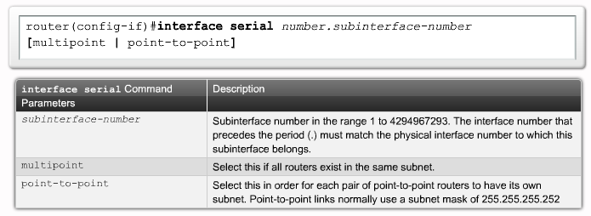
Configuring Frame Relay Subinterfaces

Slide 34
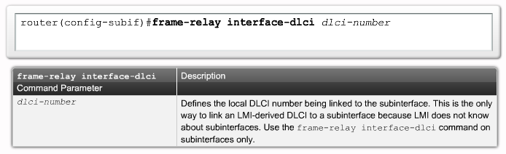
Configuring Frame Relay Subinterfaces

Slide 35
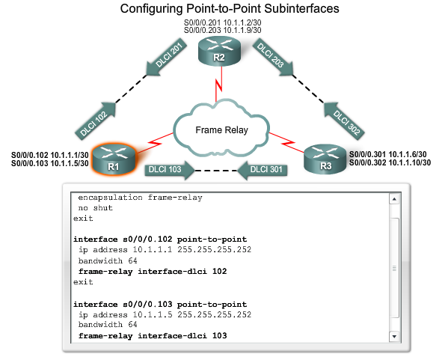
Configuring Frame Relay Subinterfaces

Slide 36
291
The output of the show frame-relay pvc command shows "PVC STATUS = INACTIVE". What does this mean?
The PVC is configured correctly and is operating normally, but no data packets have been detected for more than five minutes.
The PVC is configured correctly, is operating normally, and is no longer actively seeking the address of the remote router.
The PVC is configured correctly, is operating normally, and is waiting for interesting traffic to trigger a call to the remote router.
The PVC is configured correctly on the local switch, but there is a problem on the remote end of the PVC.
The PVC is not configured on the local switch.

Slide 37
292

Slide 38
293
Refer to the exhibit. In the Frame Relay network, which IP addresses would be assigned to the interfaces with point-topoint PVCs?

Slide 39
293
DLCI 16: 192.168.10.1 /24
DLCI 17: 192.168.10.1 /24
DLCI 99: 192.168.10.2 /24
DLCI 28: 192.168.10.3 /24
DLCI 16: 192.168.10.1 /24
DLCI 17: 192.168.11.1 /24
DLCI 99: 192.168.12.1 /24
DLCI 28: 192.168.13.1 /24
DLCI 16: 192.168.10.1 /24
DLCI 17: 192.168.11.1 /24
DLCI 99: 192.168.10.2 /24
DLCI 28: 192.168.11.2 /24
DLCI 16: 192.168.10.1 /24
DLCI 17: 192.168.10.2 /24
DLCI 99: 192.168.10.3 /24
DLCI 28: 192.168.10.4 /24

Slide 40
294
Which command is used to enable CHAP authentication, with PAP as the fallback method, on a serial interface?
Router(config-if)# ppp authentication chap fallback ppp
Router(config-if)# ppp authentication chap pap
Router(config-if)# authentication ppp chap fallback ppp
Router(config-if)# authentication ppp chap pap

Slide 41
295
Which protocol is an open standard protocol framework that is commonly used in VPNs, to provide secure end-to-end communications?
RSA
L2TP
IPsec
PPTP

Slide 42
296
At which layer of the OSI model does PPP perform?
Layer 2
Layer 3
Layer 4
Layer 5

Slide 43
297
The command frame-relay map ip 10.121.16.8 102 broadcast was entered on the router. Which of the following statements is true concerning this command?
This command should be executed from the global configuration mode.
The IP address 10.121.16.8 is the local router port used to forward data.
102 is the remote DLCI that will receive the information.
This command is required for all Frame Relay configurations.
The broadcast option allows packets, such as RIP updates, to be forwarded across the PVC.

Slide 44
298
Which two options are valid WAN connectivity methods? (Choose two.)
PPP
WAP
DSL
L2TPv3
Ethernet

Slide 45
299
Which Layer 2 protocol encapsulation type supports synchronous and asynchronous circuits and has built-in security mechanisms?
HDLC
PPP
X.25
Frame Relay

Slide 46
300
Which encapsulation type is a Frame Relay encapsulation type that is supported by Cisco routers?
IETF
ANSI Annex D
Q9333-A Annex A
HDLC

Slide 47
301
RouterA is unable to reach RouterB. Both routers are running IOS version 12.0. After reviewing the command output and graphic, what is the most likely cause of the problem?
incorrect bandwidth configuration
incorrect LMI configuration
incorrect map statement
incorrect IP address

Slide 48
302
Refer to the exhibit. What is the meaning of the term dynamic as displayed in the output of the show frame-relay map command shown?
The Serial0/0 interface is passing traffic.
The DLCI 100 was dynamically allocated by the router.
The Serial0/0 interface acquired the IP address of 172.16.3.1 from a DHCP server.
The DLCI 100 will be dynamically changed as required to adapt to changes in the Frame Relay cloud.
The mapping between DLCI 100 and the end station IP address 172.16.3.1 was learned through Inverse ARP.

Slide 49
303
A network administrator needs to configure a serial link between the main office and a remote location. The router at the remote office is a non-Cisco router. How should the network administrator configure the serial interface of the main office router to make the connection?
Main(config)# interface serial 0/0
Main(config-if)# ip address 172.16.1.1 255.255.255.252
Main(config-if)# no shut
Main(config)# interface serial 0/0
Main(config-if)# ip address 172.16.1.1 255.255.255.252
Main(config-if)# encapsulation ppp
Main(config-if)# no shut
Main(config)# interface serial 0/0
Main(config-if)# ip address 172.16.1.1 255.255.255.252
Main(config-if)# encapsulation frame-relay
Main(config-if)# authentication chap
Main(config-if)# no shut
Main(config)# interface serial 0/0
Main(config-if)#ip address 172.16.1.1 255.255.255.252
Main(config-if)#encapsulation ietf
Main(config-if)# no shut

Slide 50
304
What are three reasons that an organization with multiple branch offices and roaming users might implement a Cisco VPN solution instead of point-to-point WAN links? (Choose three.)
reduced cost
better throughput
broadband incompatibility
increased security
scalability
reduced latency

Slide 51
305
Which two statistics appear in show frame-relay map output? (Choose two.)
the number of BECN packets that are received by the router
the value of the local DLCI
the number of FECN packets that are received by the router
the status of the PVC that is configured on the router
the IP address of the local router

Slide 52
306
Users have been complaining that their Frame Relay connection to the corporate site is very slow. The network administrator suspects that the link is overloaded. Based on the partial output of the Router# show frame relay pvc command shown in the graphic, which output value indicates to the local router that traffic sent to the corporate site is experiencing congestion?

Slide 53
306
DLCI = 100
last time PVC status changed 00:25:40
in BECN packets 192
in FECN packets 147
in DE packets 0

Slide 54
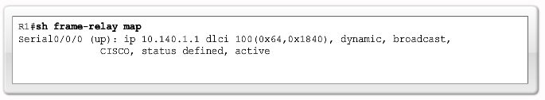
307
Which command allows you to verify the encapsulation type (CISCO or IETF) for a Frame Relay link?
show frame-relay lmi
show frame-relay map
show frame-relay pvc
show interfaces serial

Slide 55
308
It has become necessary to configure an existing serial interface to accept a second Frame Relay virtual circuit. Which of the following procedures are required to accomplish this task? (Choose three.)
Remove the IP address from the physical interface.
Encapsulate the physical interface with multipoint PPP.
Create the virtual interfaces with the interface command.
Configure each subinterface with its own IP address.
Disable split horizon to prevent routing loops between the subinterface networks.
Configure static Frame Relay map entries for each subinterface network.

Slide 56
309
What occurs on a Frame Relay network when the CIR is exceeded?
All TCP traffic is marked discard eligible.
All UDP traffic is marked discard eligible and a BECN is sent.
All TCP traffic is marked discard eligible and a BECN is sent.
All traffic exceeding the CIR is marked discard eligible.

Slide 57
310
Which two statements about using the CHAP authentication mechanism in a PPP link are true? (Choose two.)
CHAP uses a two-way handshake.
CHAP uses a three-way handshake.
CHAP authentication periodically occurs after link establishment.
CHAP authentication passwords are sent in plaintext.
CHAP authentication is performed only upon link establishment.
CHAP has no protection from playback attacks.

Slide 58
311
Refer to the exhibit. Which statement describes DLCI 17?
DLCI 17 describes the ISDN circuit between R2 and R3.
DLCI 17 describes a PVC on R2. It cannot be used on R3 or R1.
DLCI 17 is the Layer 2 address used by R2 to describe a PVC to R3.
DLCI 17 describes the dial-up circuit from R2 and R3 to the service provider.

Slide 59
312
What is the result of issuing the frame-relay map ip 192.168.1.2 202 broadcast command?
defines the destination IP address that is used in all broadcast packets on DCLI 202
defines the source IP address that is used in all broadcast packets on DCLI 202
defines the DLCI on which packets from the 192.168.1.2 IP address are received
defines the DLCI that is used for all packets that are sent to the 192.168.1.2 IP address

Slide 60
313
Which PPP subprotocol negotiates authentication options?
NCP
ISDN
SLIP
LCP
DLCI

Slide 61
314
What are two characteristics of Frame Relay point-to-point subinterfaces? (Choose two.)
They create split-horizon issues.
They require a unique subnet within a routing domain.
They emulate leased lines.
They are ideal for full-mesh topologies.
They require the use of NBMA options when using OSPF.

Slide 62
315
What command is used to verify the DLCI destination address in a Frame Relay static configuration?
show frame-relay pvc
show frame-relay lmi
show frame-relay map
show frame relay end-to-end

Slide 63
316
What is the purpose of Inverse ARP?
to map a known IP address to a MAC address
to map a known DLCI to a MAC address
to map a known MAC address to an IP address
to map a known DLCI to an IP address
to map a known IP address to a SPID
to map a known SPID to a MAC address

